Slide 1


Slide 2

Microsoft SQL Server 2014: In-Memory OLTP Customer Deployments and Lessons Learned
DBI-B313
Kevin Farlee – Microsoft
Rick Kutschera – BWIN.Party
Michael Steineke – Edgenet
Emanuel Rivera - Microsoft

Slide 3
In-Memory OLTP Application Patterns
Applications hitting a wall today with SQL Server
Locking/Latching
Scale-up
Throughput or latency SLA
Common Scenarios
Session State Management
High Data Input Rate – “Shock Absorber”
ETL Target/Read-Scale
Latency critical OLTP
Applications which do not use
SQL Server today
Key/Value pair where desire relational characteristics
Scenarios where previously might not have implemented database in the critical path

Slide 4
In-Memory OLTP Application Patterns
Applications hitting a wall today with SQL Server
Locking/Latching
Scale-up
Throughput or latency SLA
Customer Implementations
BWin.party
SQL Common Labs
Edgenet
SBILM
Applications which do not use
SQL Server today
Key/Value pair where desire relational characteristics
Scenarios where previously might not have implemented database in the critical path

Slide 5
Bwin.party

Slide 6
Company Profile
Largest regulated online entertainment provider worldwide
Sports betting, Poker, Casino, Skillgames, Bingo, …
>150.000 active users daily
Up to 30.000 different sports bets offered per day
Approx. 1 mio new users every year
Yearly revenue ~ 650 Million Euro

Slide 7
Application overview

Slide 8
Characteristics
Massively scaled out Frontend
State coordination on a single database (per farm)
Every web page impression generates two batches at the database
Very high peak loads
Session size > 8 KB

Slide 9
At the database…
High volume
BLOB like data
Short lived records
High update rate
Data itself is transient
Little harm if data is lost
Availability and consistency are key…

Slide 10
Problem
Scaling bottleneck due to latch contention
Maximum throughput ~15.000 batches/sec
Even when using RamDrive as storage
Exponential load with increased latency
Increased latency means longer response times for the client
When the response time hits a certain mark clients will retransmit the request
That will even further increase the load on the database
And further increase the response time for the client…
„Client side“ code not under our control

Slide 11
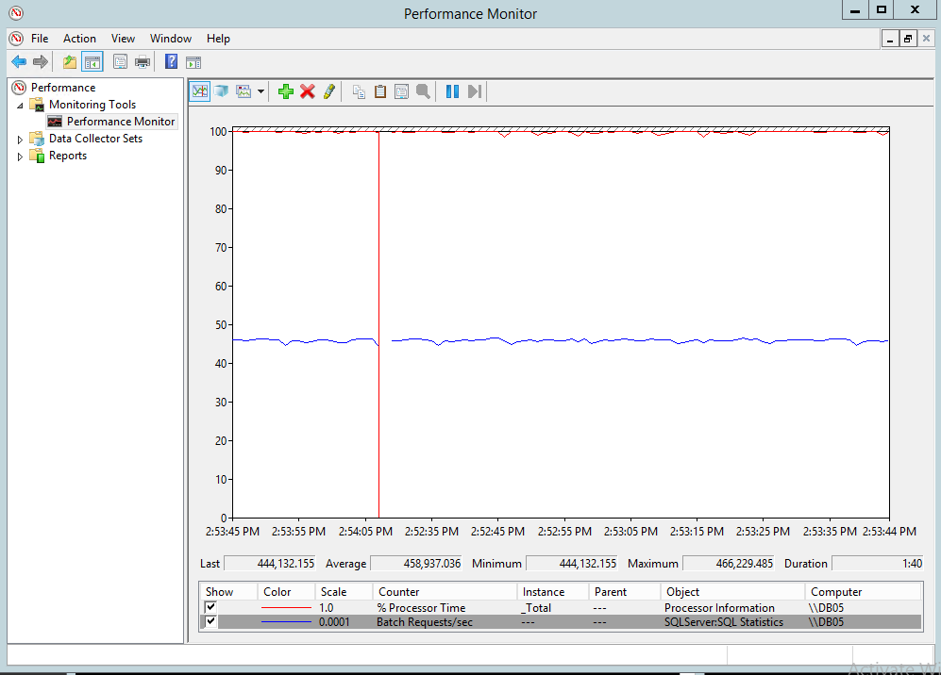
Result

Slide 12
Migration considerations
Need to keep 100% compatibility to the clients
BLOB handling required
99% of requests use point lookup based on primary key
Deferred durability vs. No durability

Slide 13
Compatibility
With stored procedures 100% compatibility is possible in almost all scenarios.
With ad hoc queries almost everything works too through Interop.
Limitations with constraints, triggers, etc
Metadata based operations (e.g. Truncate)
Error handling (Write/Write conflicts)

Slide 14
Error handling
WHILE @IsDone=0
BEGIN
BEGIN TRY
UPDATE dbo.ASPStateTempSessions_Hekaton WITH (SNAPSHOT)
SET ...
WHERE SessionId=@ID
EXEC dbo.BuildVarBinaryMax @id, @FullImage OUTPUT
SET @IsDone=1
END TRY
BEGIN CATCH
SET @error = error_number()
if (@error = 41302)
WAITFOR DELAY '00:00:00:001'
ELSE THROW
END CATCH
END

Slide 15
BLOBs
No native support in the Hekaton engine
Workaround via data splitting
Caution with consistency
Zombie problems

Slide 16
Things to consider
Different locking behavior
BUCKET_COUNT in hash indexes
TRUNCATE is not supported
No ALTER of either procedures or tables
Hardware scaling (NUMA)
Watch for memory consumption
Buffer pool starvation
Be aware of missing features (e.g. constraints)

Slide 17
SQL Common Labs High Data Input Rate – “Shock Absorber”

Slide 18
SQL Common Labs
Profile
Service for the development and test teams for Data Platform Group
Need to provide near-realtime access to availability, exception and telemetry data
Collect data for 8,100 client and server machines
Project Description
Event Reporting collects and reports on events such as Perf Counters, Exceptions, Stack Traces
Web Service API collects the data and streams into Event database
Problem: Unable to handle spikes above 3,800 transactions/sec input data rate would result in backup due to latching
Resulted in gaps in the data

Slide 19
Event Reporting Architecture
SQL Server Reporting Services
Power Pivot
Perf Counters
Exceptions
Stack Traces
Web Service
Standard T-SQL stored procedure
Disk-based tables
Standard T-SQL stored procedure
Natively-compiled stored procedure
In-Memory tables
SQL Agent job
Disk-based tables
Hot Data (Real-Time)
Current 5 Minutes
Cold Data
5 Minutes to 30 days
Approx. 1.5B records

Slide 20
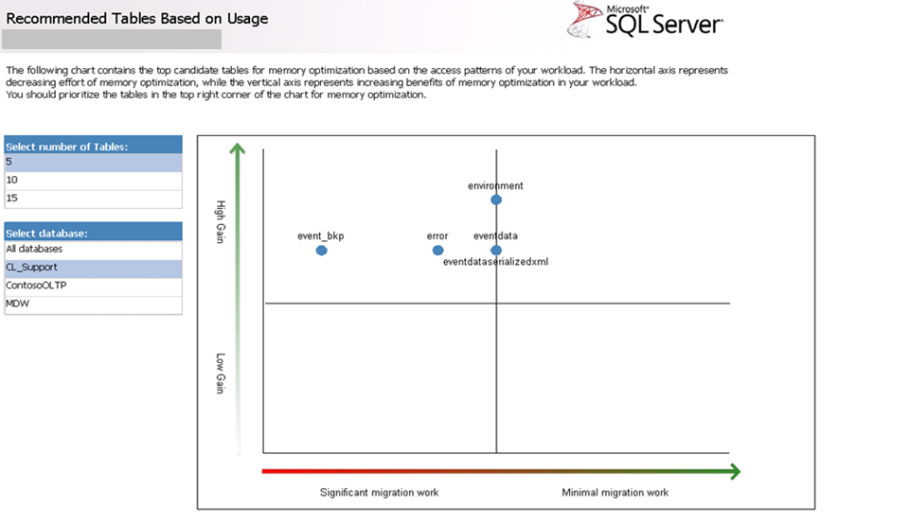
AMR Table Usage

Slide 21
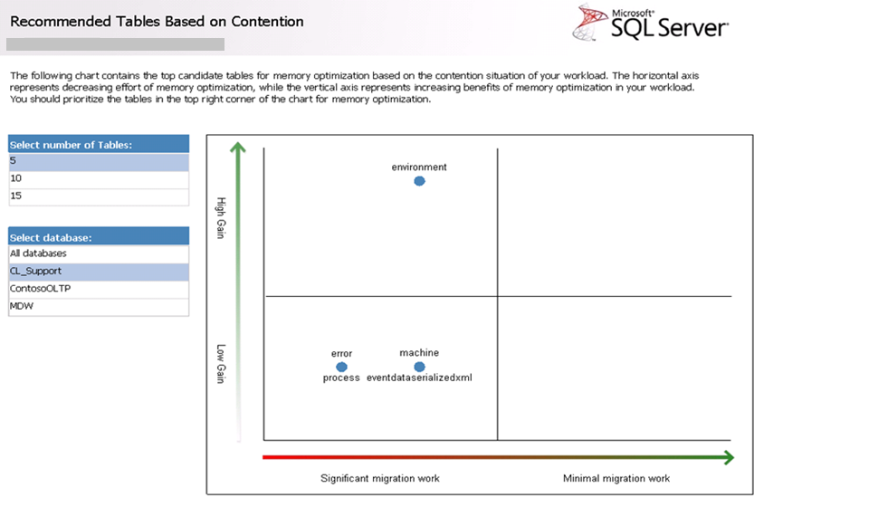
AMR Table Contention

Slide 22
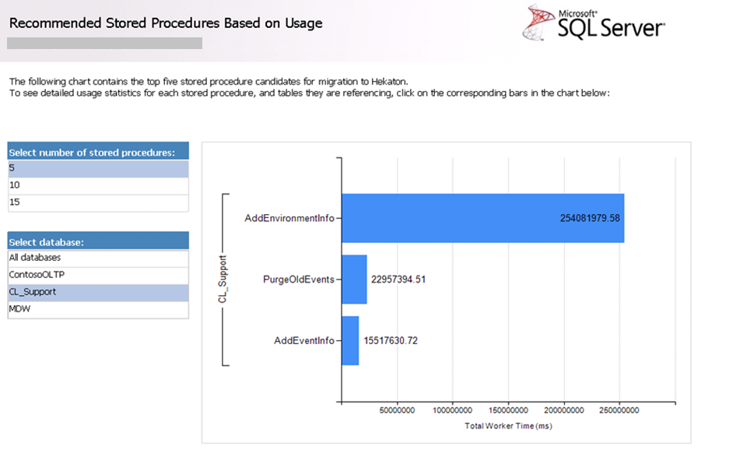
AMR Stored Procedure Usage

Slide 23
Implementation
Memory Optimized Tables | Size in-Memory: ~3 GB, 3 tables out of 28 user tables Rows in largest tables: 17.3 million (Event) ~300k for EventDetail (40MB) Durability: SCHEMA_AND_DATA Indexing: HASH and nonclustered ordered Update-stats: Daily
Native Compiled Procedures | Conversions Required: Converted inserts to native procs Only do inserts and deletes (no updates) InterOp Wrappers for insert (due to Foreign Key limit) Read queries are all InterOp
Hardware | R820: 512GB memory allocated, 24-core (4x6) logical CPU’s, SAN storage
Integration with other features | SQL Server AlwaysOn AG’s (sync) and using Readable Secondary with In-Memory OLTP. SQL Server Managed Backup to Windows Azure
Development time | 1.5 weeks although TAP Builds with new functionality extended the time

Slide 24
Move cold data from In-Memory to Disk Based Tables Waterfall Process / Application-Level Partitioning
CREATE PROCEDURE usp_ExtractHkEnvironmentData @cutOffDate datetime
WITH NATIVE_COMPILATION, SCHEMABINDING, EXECUTE AS OWNER
AS BEGIN ATOMIC WITH
(
TRANSACTION ISOLATION LEVEL = SERIALIZABLE,
LANGUAGE = 'english'
)
SELECT
[createdate]
,[updatedate]
,[envhk].[id]
,[eventid]
,[namevalueid]
,[name]
,[value]
FROM [evs].[environment_HK] envhk
WHERE [createdate] < @cutOffDate
DELETE FROM [evs].[environment_HK] WHERE [createdate] < @cutOffDate
END
GO
http://technet.microsoft.com/en-us/library/dn296452(v=sql.120).aspx

Slide 25
Move cold data from In-Memory to Disk Based Tables Waterfall Process – Continued
CREATE PROCEDURE [dbo].[MoveInMemoryDataToDiskBased]
@numHours int = 1
AS
BEGIN
SET TRANSACTION ISOLATION LEVEL READ COMMITTED
DECLARE @rowCount INT = 1
DECLARE @cutOffDate datetime = DATEADD(HH,-1 * @numHours, GETDATE())
WHILE (@rowCount > 0)
BEGIN
BEGIN TRAN
INSERT INTO [evs].[environment]([createdate],[updatedate],[id],[eventid],[namevalueid],[name],[value])
EXEC [dbo].[usp_ExtractHkEnvironmentData] @cutOffDate
SET @rowCount = @@ROWCOUNT
IF (@rowCount > 0 AND @@ERROR = 0)
COMMIT TRAN
ELSE
ROLLBACK TRAN
END
END
GO

Slide 26
In-Memory OLTP Results
6x Gains input rate
Now can handle up to 23,500 trans/sec – absorb the writes
Measured at the application level
SQL Server: Databases - Transactions/sec
XTP Transactions created/sec
Daily reports 30-80% reduction in execution time (using InterOp)
Disk-based: 1-3 minutes on TOP 3 queries
Memory-Optimized: 12 seconds to 2 min
Now can accomplish near real-time analysis of issues and handle the input workload
Alerting also more real-time in nature

Slide 27
Lessons Learned
No. | Challenge | Resolution/Mitigation
1 | Assessing workload for In-Memory OLTP | Using AMR toolset to analyze workload and confirm bottleneck was helpful
2 | Initial approach was to move entire contention heavy table into memory-optimized (1.5B Records / 175GB) | Using “Shock Absorber” and moving data past 5 min to disk-based tables more beneficial for long running reporting and data retention
3 | Working with LOB data | Limited row size to 7000 per row in the application and schema
4 | Foreign Key Constraints – Detail records of 50-100 based on primary table key | Developed manual checks in native compiled stored procedure calls to check for data consistency
5 | Measuring application performance in database counters changed | Measured at the application level. Used a combination of SQL Transactions/sec and XTP Transactions – Transactions created/sec

Slide 28
Edgenet ETL Target and Read-Scale

Slide 29

Edgenet
Company Profile
Leader in Data Services, Guided Selling and Marketing Solutions
Help retailers sell configurable products
Help consumers compare and purchase the right product for them.
Collect, certify and distribute product data
Bing and Google Search & Shopping and for Retailers
Project Description
Availability Project goal: Provide real-time insight into product price and availability for retailers and end-consumers
Pre-migration system design: Updated data in batches into staging server, then separate batch push to read-only DB server for client queries
Required: Multi-server, multi-tenant to separate ETL loading and reads from lock contention.
Data cache implemented in client tier to improve read performance
Data was delayed to end-users by hours due to this data distribution and need to move data to different destinations

Slide 30
Edgenet - Architecture Real-time “ETL” updates
Interactive Sites
Retailers
Suppliers
Receive file from suppliers (periodically, but looking for more real-time)
Desire to query for the availability of products at particular prices within stores or online

Slide 31
Implementation
Memory Optimized Tables | Size in Memory: ~6 GB, 2 out of 10 tables Rows in largest tables: 115 million, another 450k Durability: SCHEMA_AND_DATA Indexing: All HASH indexes
Native Compiled Procedures | Conversions Required: Converted all transformation operations Selects from clients, including INNER JOIN Able to remove client-side cache and replace with native proc calls. InterOp: Did not convert Bulk INSERT syntax.
Hardware | Hyper-V VM: 128GB memory, 16 logical CPU’s, SAN storage
Integration with other features | Delayed Durability configured at database level. No requirement for HA/DR
Development time | Under a week of development & initial testing time

Slide 32
In-Memory OLTP Results
After In-Memory Migration
Single DB Server
Single DB
Update data in same batches, as fast as it is received
Added quantity on hand not just whether it is available or not
8x to 11x (varied based on size of batch)
Client read workload is unaffected by updates
Application tier cache is no longer necessary
Read calls to database are smaller and more efficient
Data is now in sync near real time

Slide 33
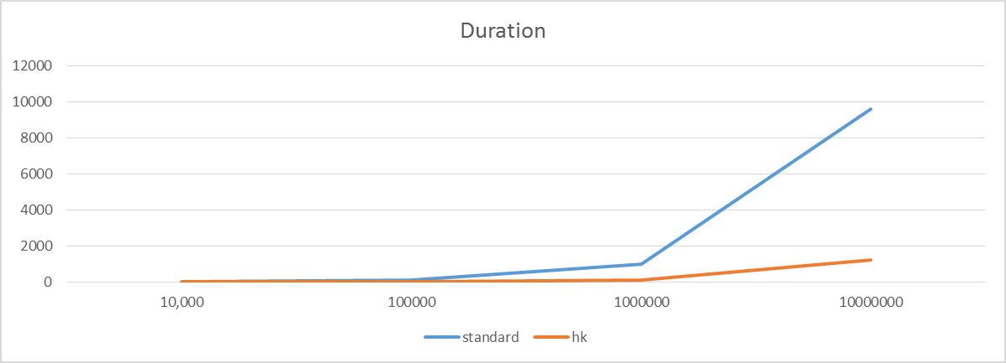
ETL - Standard vs. Memory Optimized
Seconds
10 Million rows processed
Standard ETL – 2 Hours 40 Minutes
Memory Optimized – 20 Minutes
Rows
Edgenet Case Study

Slide 34
Lessons Learned
No. | Challenge | Resolution/Mitigation
1 | Developing a plan on what to migrate | Started with single table, then iterated as new bottleneck manifested. Ended up moving second table to In-Memory OLTP Engine to satisfy joins in native procedures.
2 | Evaluating performance and potential disk latency | Having the ability to re-submit/reproduce the data load were able to implement Delayed Durability to alleviate dependency on disk IO from critical path.
3 | Tested with SEQUENCE object (had IDENTITY) | Determined they had a natural key and that it was easier to handle this sequencing logic outside of database

Slide 35
SBI Liquidity Market Low latency and High Throughput OLTP

Slide 36

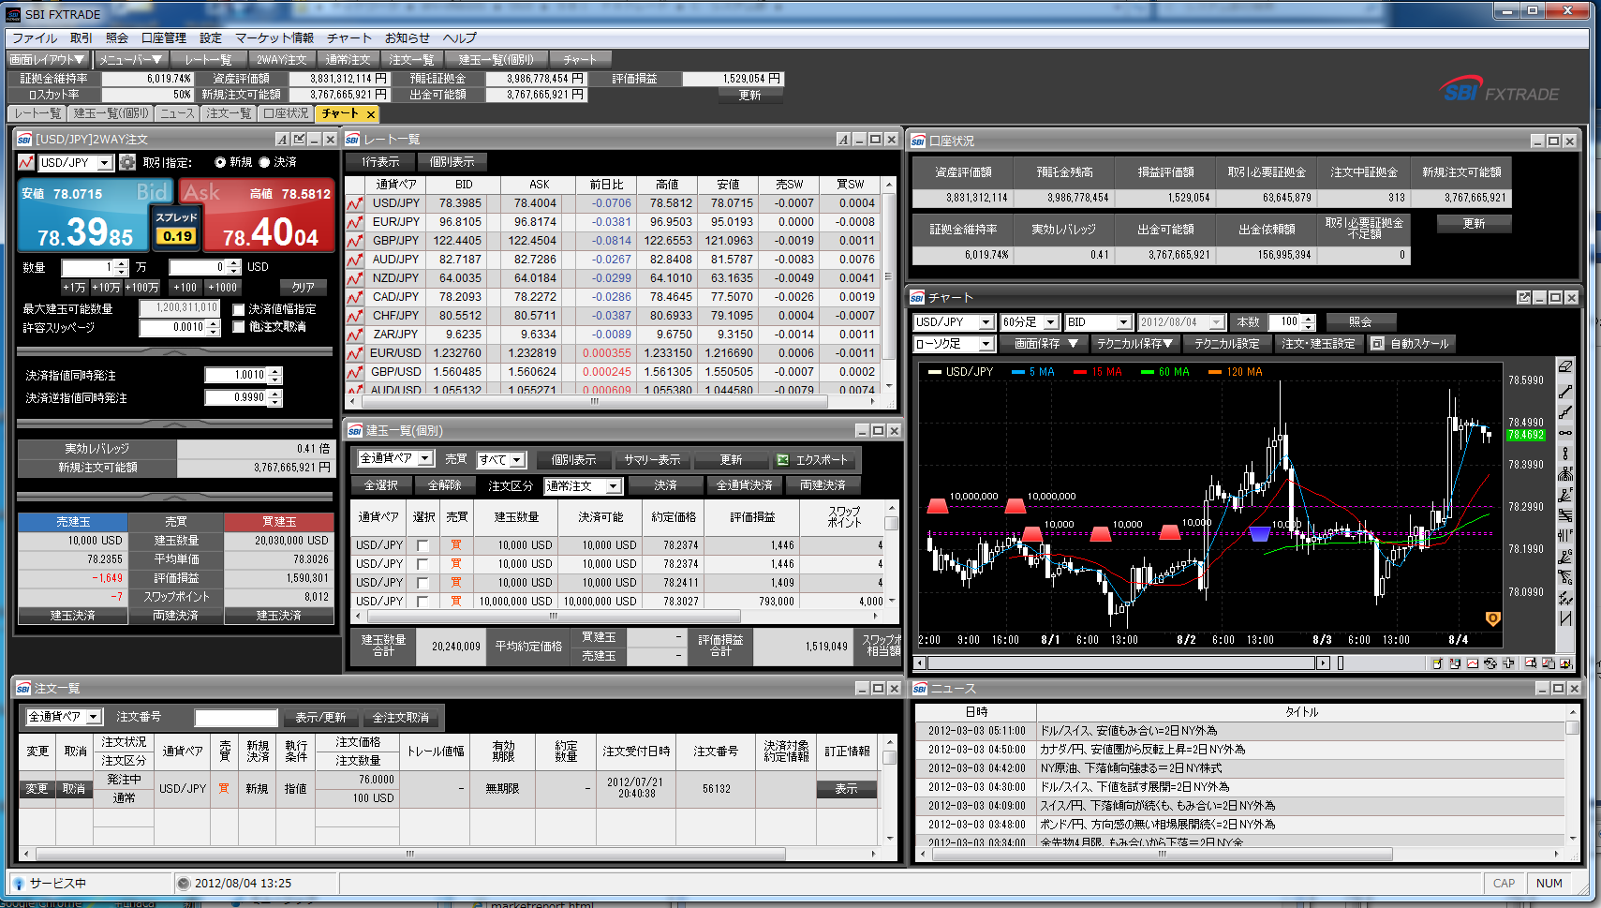
SBI Liquidity Market Co., Ltd.
Company Profile
SBI (Strategic Business Investments) group is a internet financial services company.
SBI Liquidity Market is a foreign exchange liquidity provider in SBI group.
Provide service and market solutions for foreign currency exchange, and associated systems
Project Description
Cover management system is for
SBILM’s in-house dealers to decide how
much inter-bank trades are need to “fill the
gap” in end users trades
Problem:
Desire to expand globally, need to “scale” system
Expecting throughput 10x volume
System had latency (up to 4 sec) at scale
Projected goal is around throughput and under 1 sec
latency

Slide 37
Architecture
Cover Management system
End-User Trading systems (Existing)
Client Application
Data Distribute
Transaction Compare
Aggregation System
In-Memory OLTP
Display
POSITION
AlwaysOn AG
AlwaysOn AG
SQL 2008 R2
SQL 2014
SQL 2014
There are 3 sets of existing trading systems = 30 trade services, expecting over 50
Trading system sends trading result to Cover management system
Trading systems can be scaled out
Cover management is not. <- Need In-Memory OLTP
Trading Log table (insert); Aggregation table (update)

Slide 38
Implementation
Memory Optimized Tables | Size in-Memory: ~8 GB, 2 tables Rows in largest tables: ~100,000 rows in trading log Durability: SCHEMA_AND_DATA Indexing: HASH and nonclustered memory-optimized tables
Native Compiled Procedures | Conversions Required: This system was developed specifically for In-Memory OLTP Almost all operation in native compiled procedures
Hardware | HP DL560 G8 (4-Socket, 8-Core) 768GB memory Data files and log files located on Fusion IO drive (2.4TB x 2)
Integration with other features | SQL Server AlwaysOn AG’s (sync)
Development time | Re-developed application along with SQL14 TAP

Slide 39
In-Memory OLTP Results
In-Memory is 2x faster
115k vs. 52k in throughput
Still investigating latency
Can even scale higher on different hardware
2 sockets using almost 100% CPU, 4 sockets limited to 44%
2 socket is faster than 4 socket
SBILM Case Study

Slide 40
Lessons Learned
No. | Challenge | Resolution/Mitigation
1 | Chatty application | Combine [n] transactions into one batch for better performance
2 | Update conflict require re-try. There are heavy updates to a few rows | Application modification to allow one thread to update a certain currency pair. This means 26 update thread for 26 currency pair
3 | Files on disk much larger than in memory table size, storage size and clean-up (merge and garbage collection) | In many cases, in-particular for small in-memory footprint this can be the case. For more details please refer to (Storage Allocation and Management for memory-optimized tables blog) Also, modified behavior in RTM
4 | Lack of parallelism with memory-optimized tables | Consider how critical parallelism is in plan (vs. native proc). Tested but currently no need to implement
5 | Inability to alter In-Memory OLTP objects (during application upgrade) | Process requires downtime: Stop workload, backup data from table, drop objects (Table, SP), create new objects, load data, set privilege, resume workload
6 | Significant performance degradation in 8-socket (glued) server | Limiting cores used to one Socket (NUMA node) improves performance

Slide 41
Summary – Lessons Learned

Slide 42
Migration Methodology
Confirm current application goals and bottlenecks
Make sure In-Memory OLTP can address the bottleneck
Understand what aspect of In-Memory OLTP can address the bottleneck
Disk-based tables:
Traditional
execution stack:
Performance
gain:
In-Memory OLTP
execution stack:
T1 (writer)
T2 (writer)
Throughput (TPS)
T3 (reader)
Page
Latch
Client Connectivity
Client Connectivity
No improvement
Query Execution
Procedure Execution
Number of threads
Data Access
(Buffer Pool)
2-10X improvement
Data Access
(Memory-Optimized)
T1 (writer)
T2 (writer)
Throughput (TPS)
Transaction Logging
Transaction Logging
Same latency
Less volume
T3 (reader)
T4 (reader)
Number of threads

Slide 43
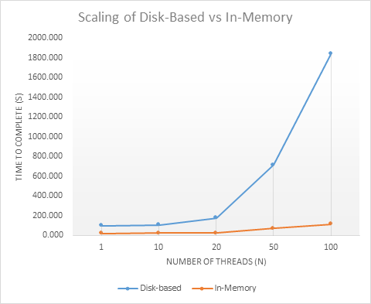
Migration Methodology
Test realistic workload
Right transaction mix, concurrency/load and table size characteristics are important
Test suites: Distributed Replay, Ostress, Visual Studio Load Test, Custom
Execute testing at scale to realize full benefits
ostress.exe -S. –E
-dAdventureWorks2012
-Q"EXEC Demo.usp_DemoInsertSalesOrders
@use_inmem = <0,1>, @order_count=100000"
–n<varies>
https://msftdbprodsamples.codeplex.com/releases/view/114491?WT.mc_id=Blog_SQL_InMem_CTP2

Slide 44
Related content at TechEd
Breakout Sessions
DBI-B287 - Microsoft SQL Server 2014: In-Memory OLTP Overview
DBI-B386 - Microsoft SQL Server 2014: In-Memory OLTP for Database Developers
DBI-B385 - Microsoft SQL Server 2014: In-Memory OLTP for Database Administrators
DBI-B384 - Microsoft SQL Server 2014: In-Memory OLTP End-to-End: Preparing for Migration
DBI-B315 - Microsoft SQL Server 2014: In-Memory OLTP: Memory/Storage Monitoring and Troubleshooting
DBI-B488 - Microsoft SQL Server 2014: In-Memory OLTP Performance Troubleshooting
DBI-B313 - Microsoft SQL Server 2014: In-Memory OLTP Customer Deployments and Lessons Learned

Slide 45

Track resources
Download Microsoft SQL Server 2014
http://www.trySQLSever.com
Try out Power BI for Office 365!
http://www.powerbi.com
Sign up for Microsoft HDInsight today!
http://microsoft.com/bigdata

Slide 46

Resources
Learning
Sessions on Demand
Microsoft Certification & Training Resources
http://channel9.msdn.com/Events/TechEd
www.microsoft.com/learning
TechNet
msdn
Resources for IT Professionals
Resources for Developers
http://microsoft.com/technet
http://microsoft.com/msdn

Slide 47



Complete an evaluation and enter to win!

Slide 48

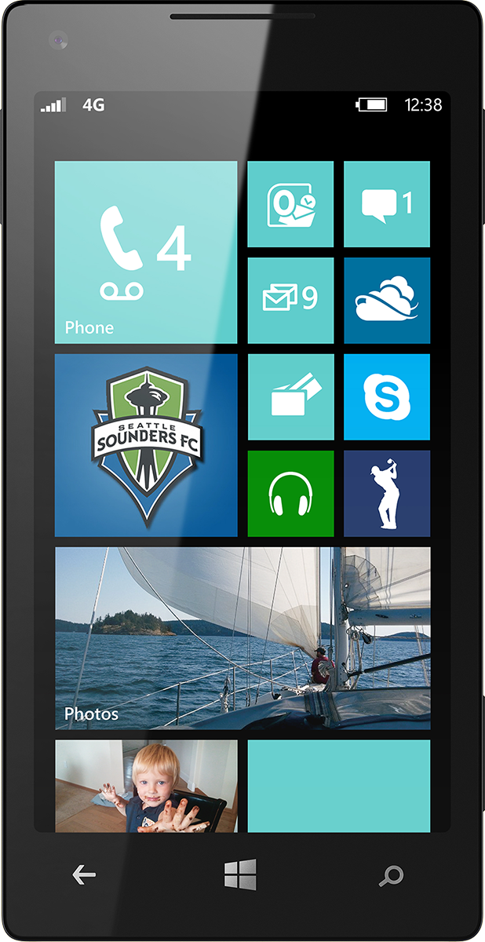
Evaluate this session
Scan this QR code to evaluate this session.

Slide 49


© 2014 Microsoft Corporation. All rights reserved. Microsoft, Windows, and other product names are or may be registered trademarks and/or trademarks in the U.S. and/or other countries.
The information herein is for informational purposes only and represents the current view of Microsoft Corporation as of the date of this presentation. Because Microsoft must respond to changing market conditions, it should not be interpreted to be a commitment on the part of Microsoft, and Microsoft cannot guarantee the accuracy of any information provided after the date of this presentation. MICROSOFT MAKES NO WARRANTIES, EXPRESS, IMPLIED OR STATUTORY, AS TO THE INFORMATION IN THIS PRESENTATION.

